Slide 1
Sentiment-Driven Video Recommendations
Iván Seldas Perulero

Slide 2
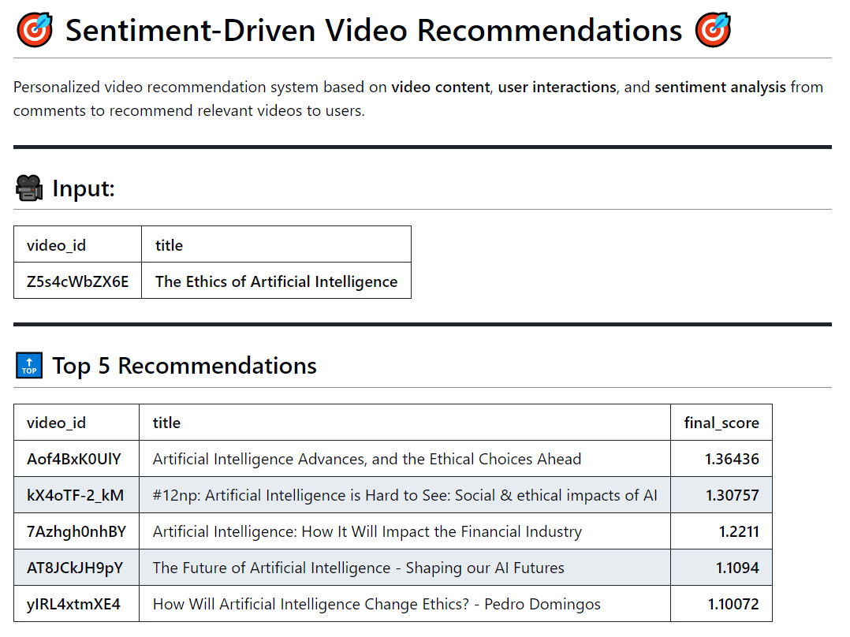

Slide 3
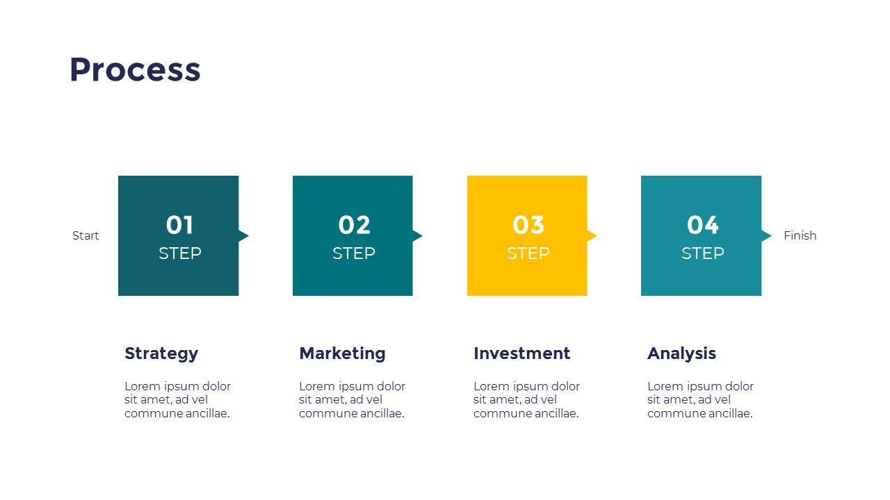
PROCESO
01
02
03
Videos recomendados
Video_id
MATRIZ DE SIMILITUD
ANÁLISIS DE SENTIMIENTOS
CLUSTERING

Slide 4
OBTENCIÓN DE DATOS REALES

Slide 5
YOUTUBE API SEARCH
TOPIC: Inteligencia Artificial
queries = [
"What is artificial intelligence?",
"Artificial intelligence applications in healthcare",
"AI in autonomous vehicles",
"Machine learning vs deep learning",
"Artificial intelligence in finance",
"How does AI work?",
"Top AI tools for data science",
"Artificial intelligence in robotics",
"AI-driven innovation in business",
]
params = {
'part': 'snippet',
'type': 'video',
'maxResults': 50,
'key': api_key,
'order': 'viewCount',
'videoDuration': 'any',
'regionCode': 'US'
}
DATOS
MATRIZ SIMILITUD
ANÁLISIS DE SENTIMIENTOS
CLUSTERING
RESULTADOS

Slide 6
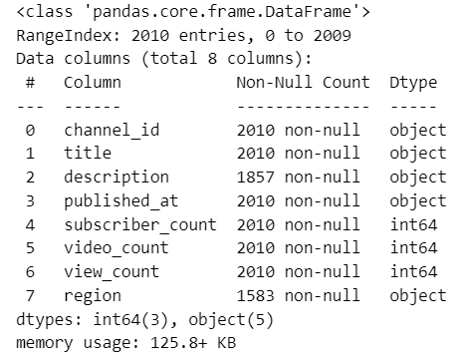
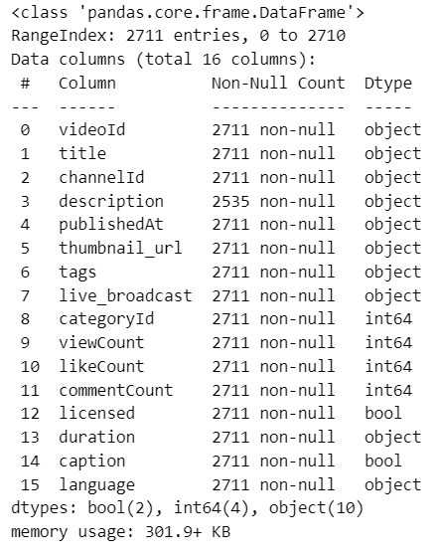
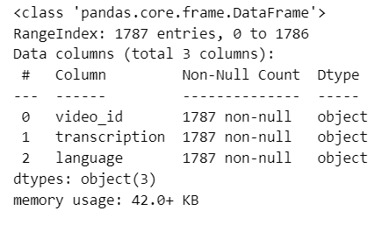
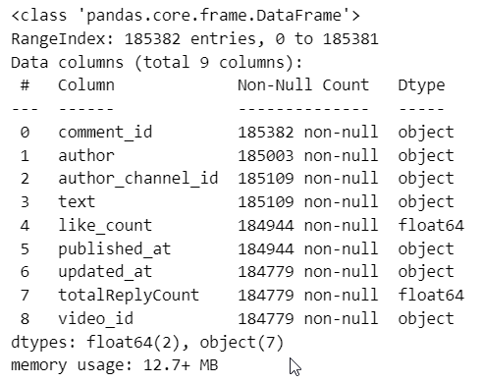
DATAFRAMES
Canales
Videos
Transcripciones
Comentarios

Slide 7
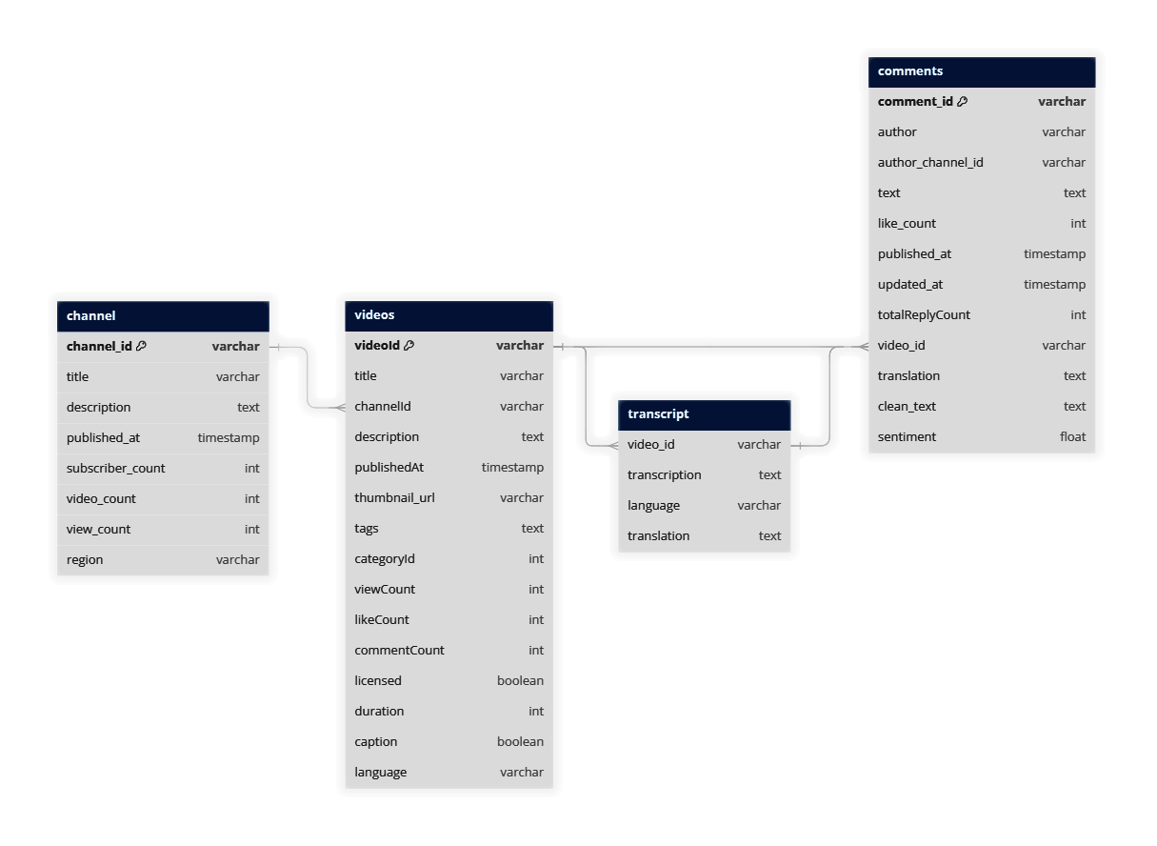
DATABASE
DATOS
MATRIZ SIMILITUD
ANÁLISIS DE SENTIMIENTOS
CLUSTERING
RESULTADOS

Slide 8
MATRIZ DE SIMILITUD
[Transcripciones]

Slide 9
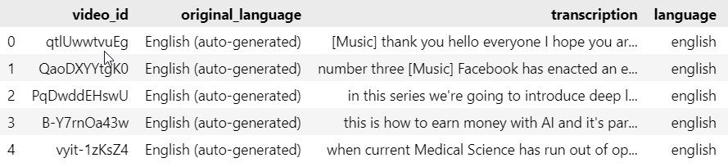
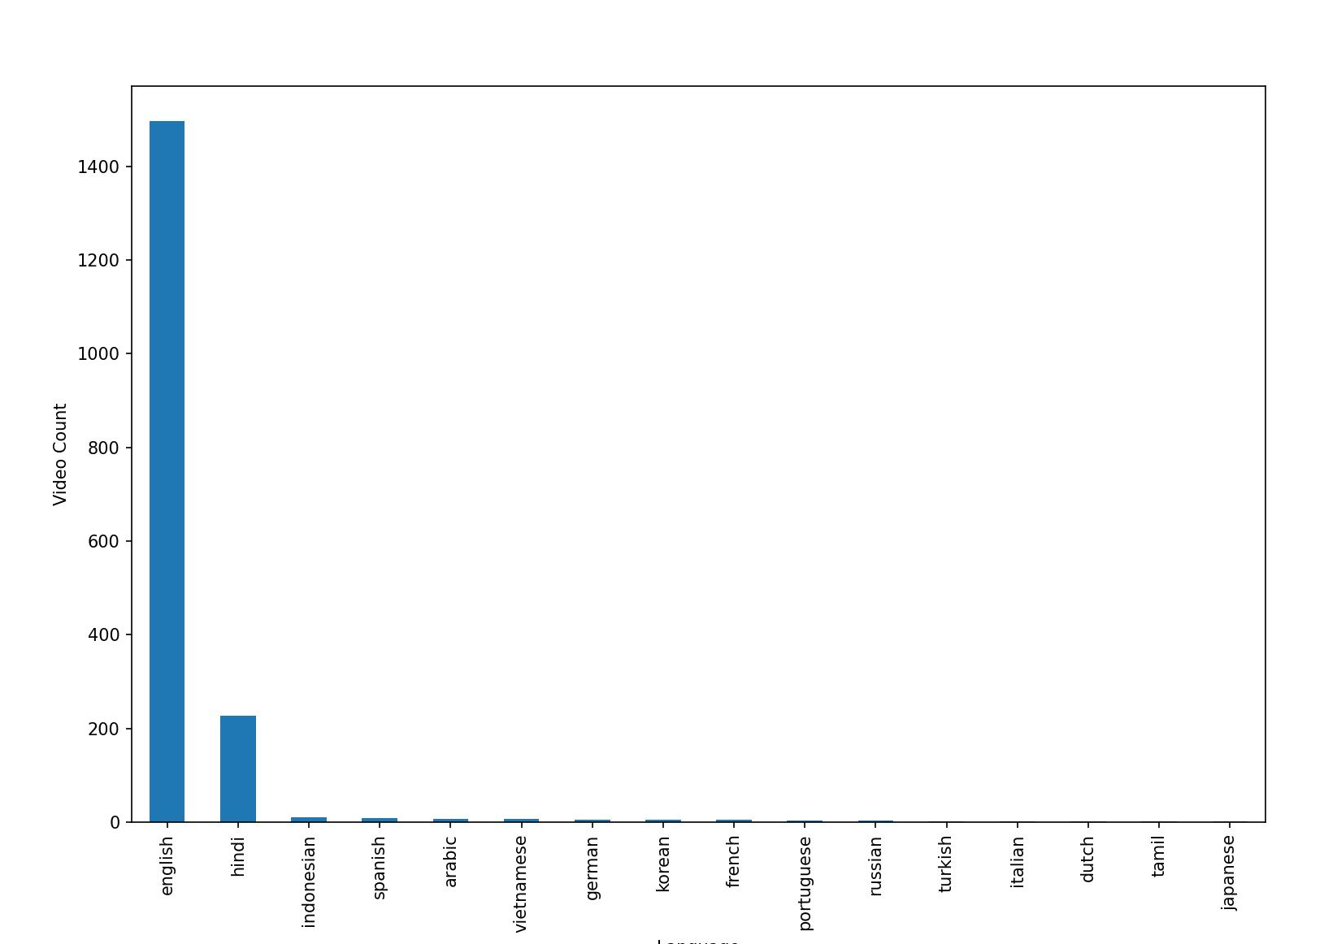
TRADUCCIÓN DE TRANSCRIPCIONES
DATOS
MATRIZ SIMILITUD
ANÁLISIS DE SENTIMIENTOS
CLUSTERING
RESULTADOS

Slide 10
PREPROCESAMIENTO DEL TEXTO
import nltk
from nltk.corpus import stopwords
from nltk.stem import WordNetLemmatizer
import string
import re
# Descargar recursos de NLTK si no están descargados
nltk.download('wordnet')
nltk.download('stopwords')
# Inicializar el lematizador en inglés
lemmatizer = WordNetLemmatizer()
# Cargar las stopwords en inglés
stop_words = set(stopwords.words('english'))
def preprocess_text(text):
if text is None:
return None
text = re.sub(r'[^a-zA-Z\s]', '', text)
text = text.lower()
text = text.translate(str.maketrans('', '', string.punctuation))
text = ' '.join([lemmatizer.lemmatize(word) for word in text.split() if word not in stop_words])
return text
Limpieza de caracteres: Se eliminan caracteres no alfabéticos.
Normalización: Convierte el texto a minúsculas.
Eliminación de ruido: Se eliminan las puntuaciones y las stopwords.
Lematización: Se reduce cada palabra a su forma básica o lema.

Slide 11
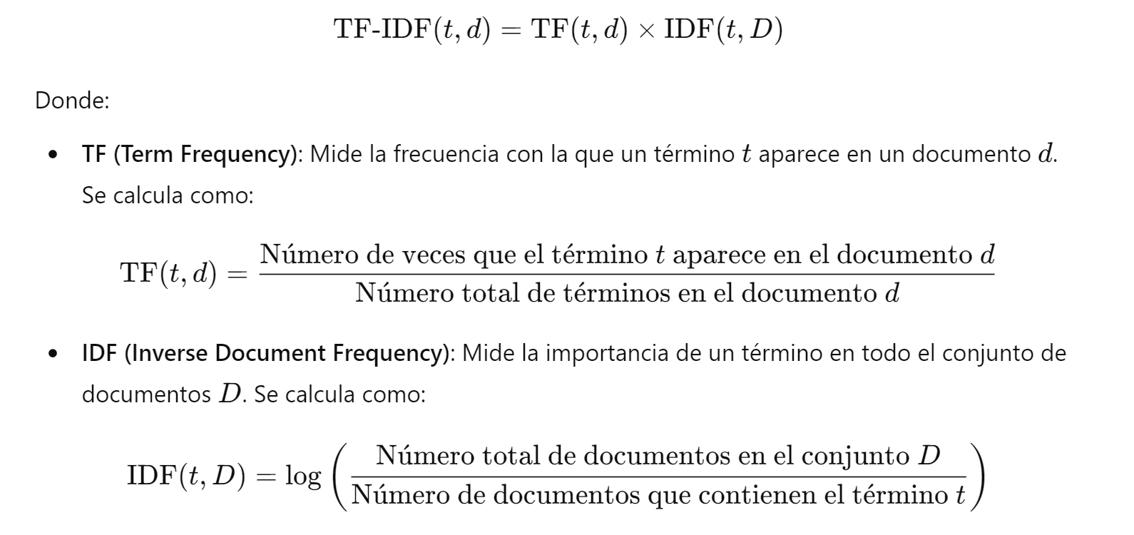
TF-IDF: Term Frequency - Inverse Document Frequency
DATOS
MATRIZ SIMILITUD
ANÁLISIS DE SENTIMIENTOS
CLUSTERING
RESULTADOS

Slide 12
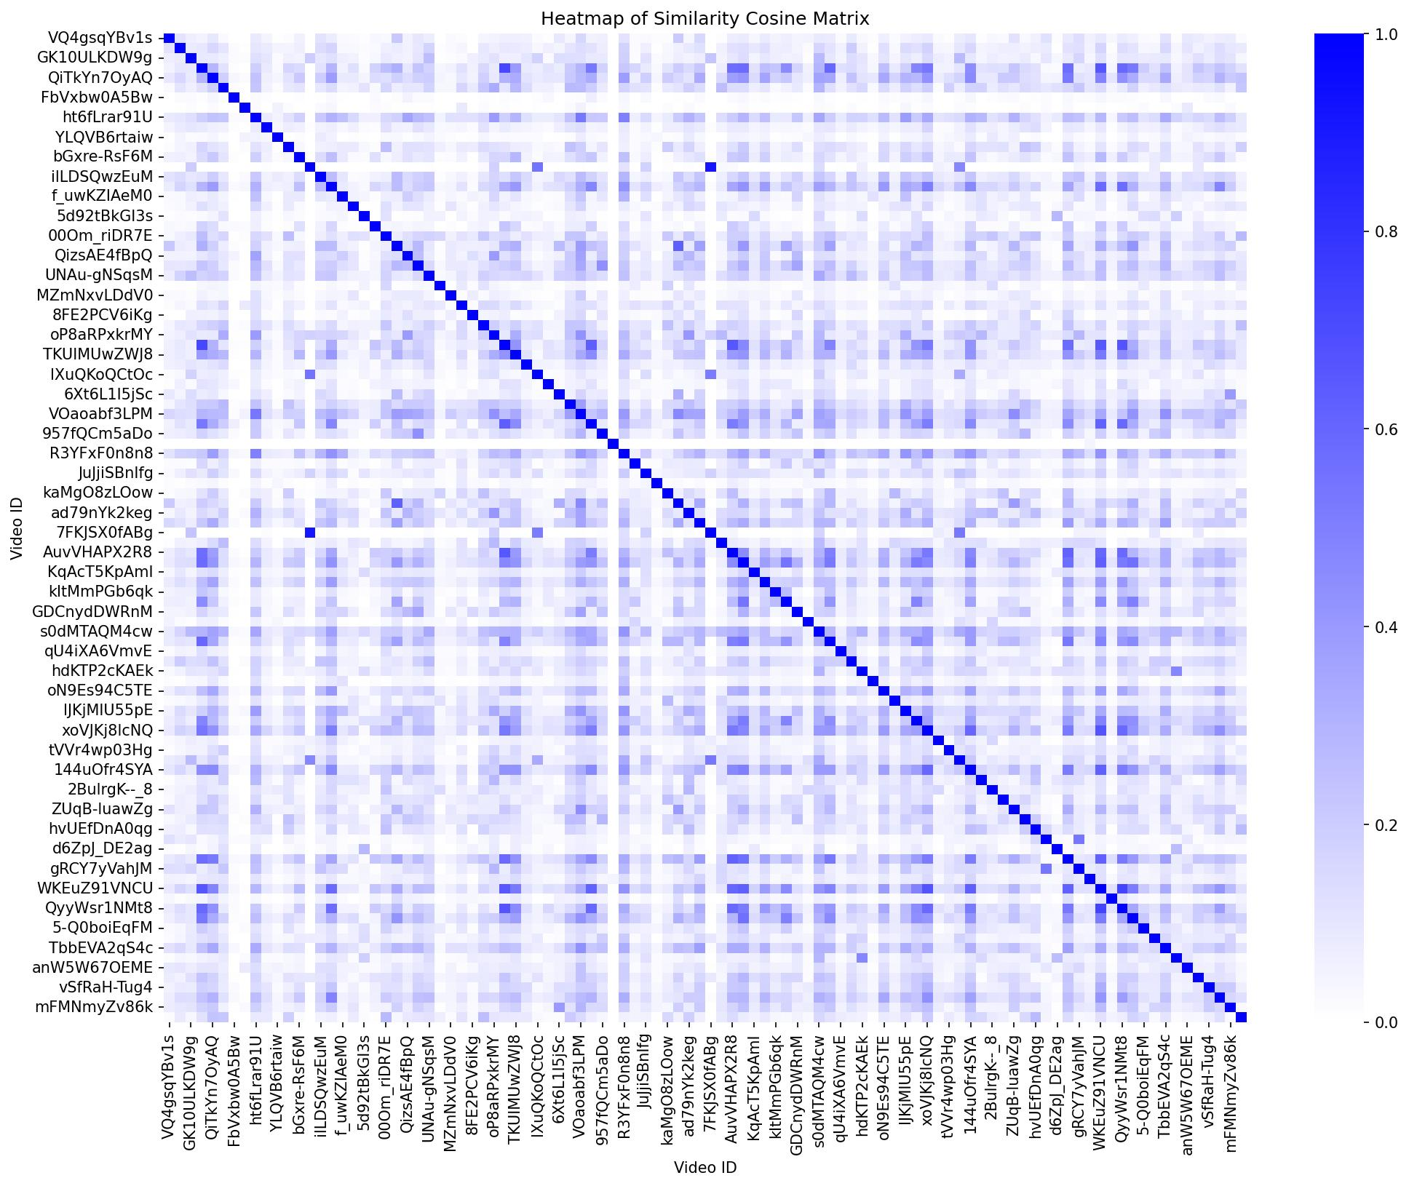
MATRIZ DE SIMILITUD: MAPA DE CALOR
DATOS
MATRIZ SIMILITUD
ANÁLISIS DE SENTIMIENTOS
CLUSTERING
RESULTADOS

Slide 13
ANÁLISIS DE SENTIMIENTOS
[Comentarios]

Slide 14
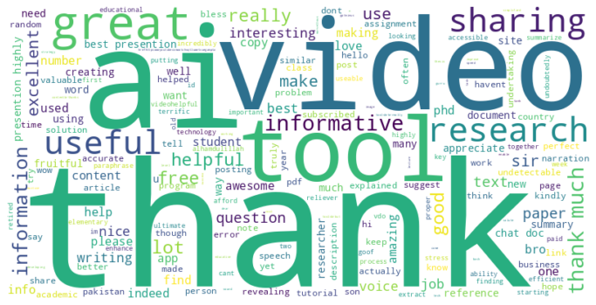
NUBE DE PALABRAS SOBRE COMENTARIO PREPROCESADO
DATOS
MATRIZ SIMILITUD
ANÁLISIS DE SENTIMIENTOS
CLUSTERING
RESULTADOS

Slide 15
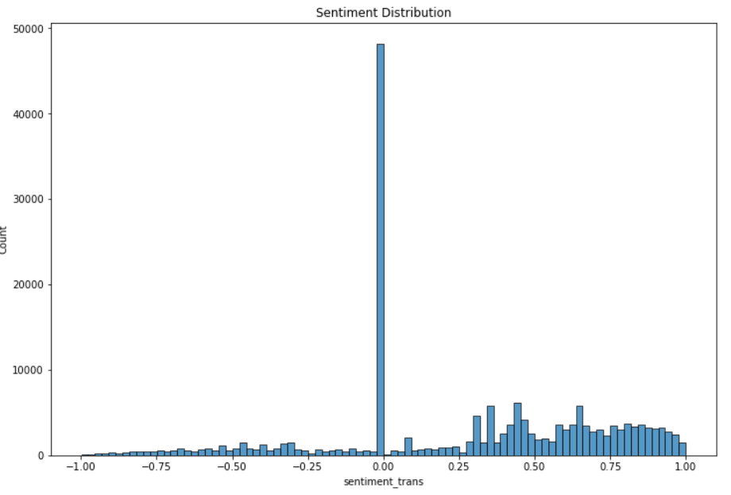
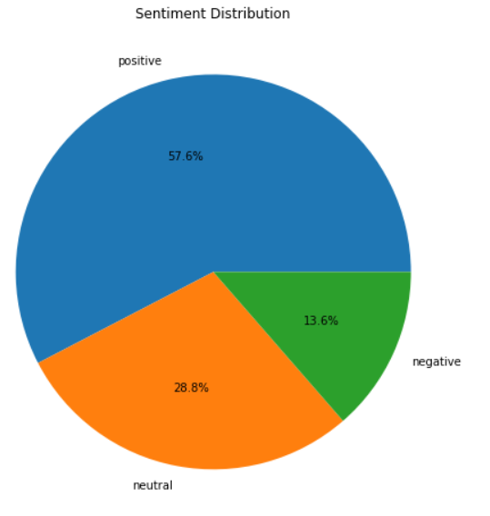
ANÁLISIS DE SENTIMIENTO UTILIZANDO VADER
Modelo que utliza un diccionario que asocia palabras con valencias o cargas emocionales:
Puntuación 1: máximo valor positivo
Puntuación 0: valor neutro
Puntuación 1: máximo valor negativo
Modificadores de intensidad:

Slide 16
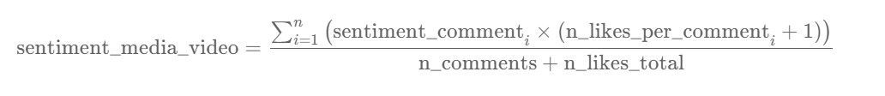
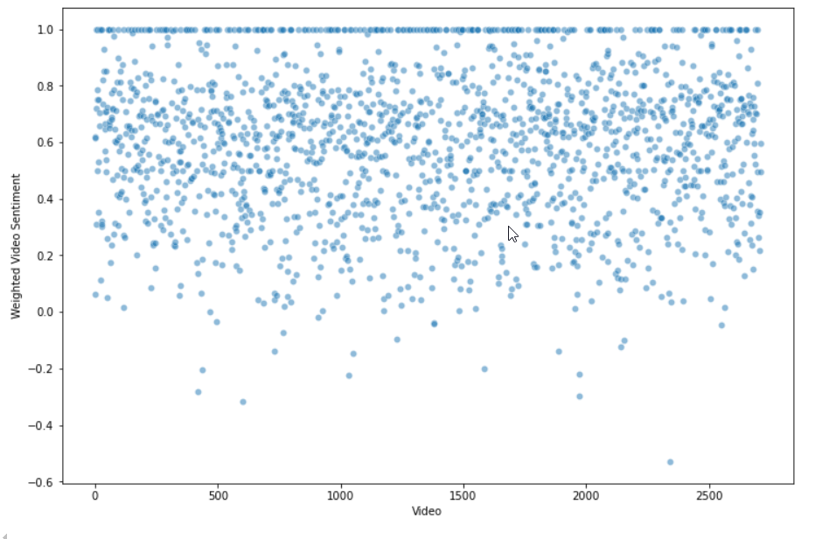
SENTIMIENTO PONDERADO POR VIDEO

Slide 17
CLUSTERING
[Estadísticas de los videos]

Slide 18
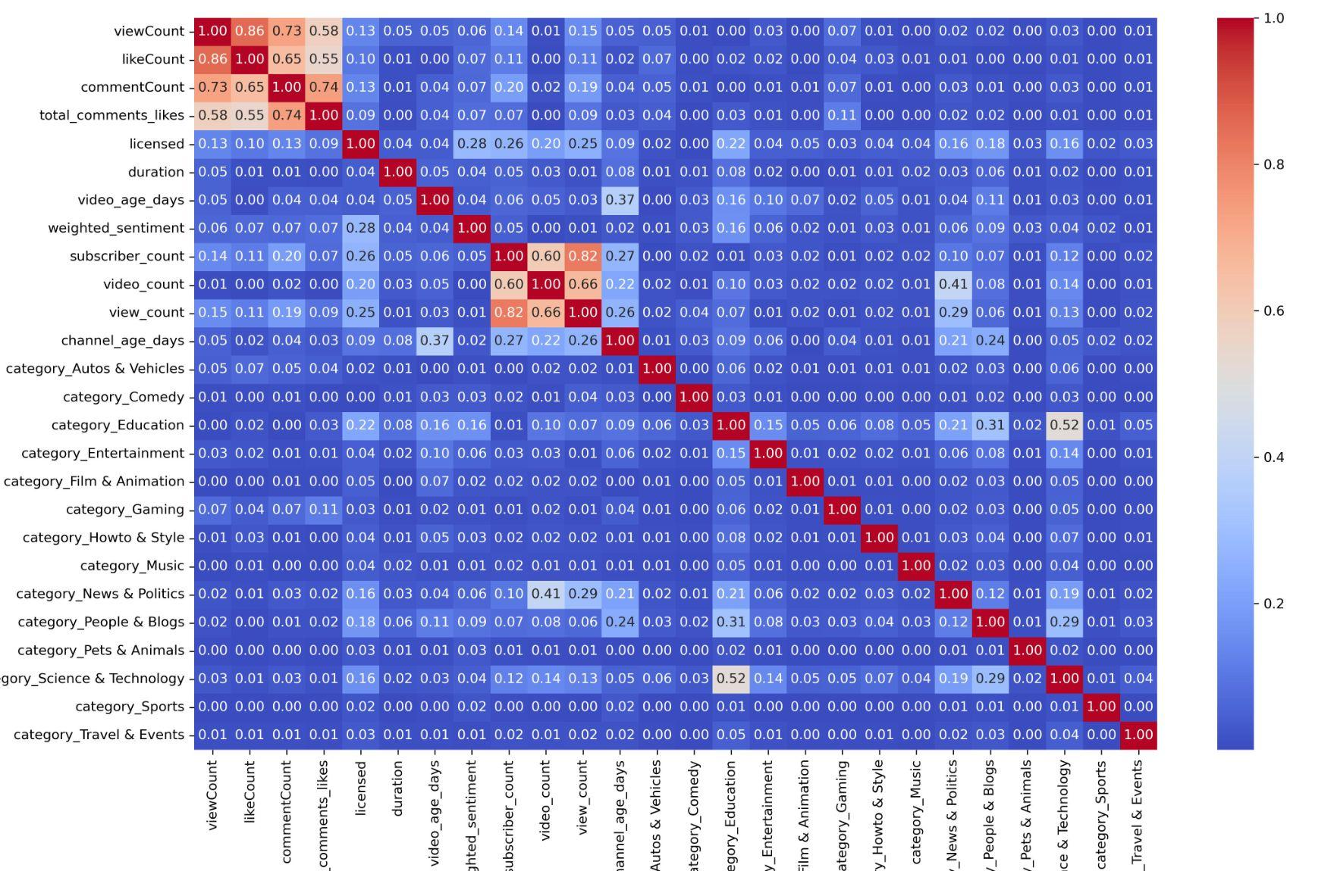
MATRIZ DE CORRELACIÓN
var_alta_corr = ['likeCount', 'total_comments_likes', 'subscriber_count']
DATOS
MATRIZ SIMILITUD
ANÁLISIS DE SENTIMIENTOS
CLUSTERING
RESULTADOS

Slide 19
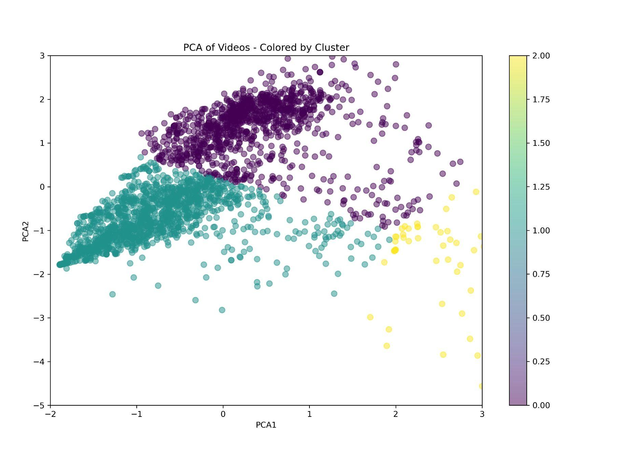
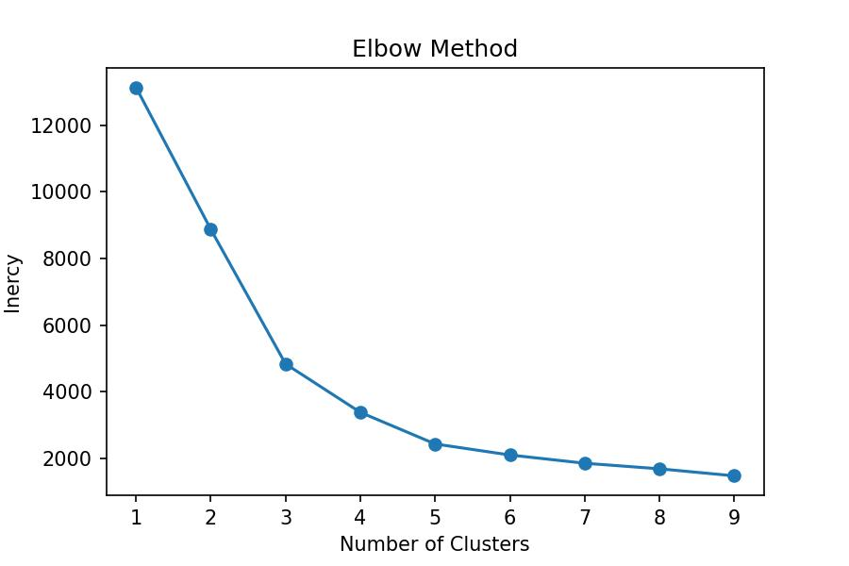
K-MEANS
kmeans = KMeans(n_clusters=3)
Calculate the silhouette score
silhouette_avg_score = 0.4566
DATOS
MATRIZ SIMILITUD
ANÁLISIS DE SENTIMIENTOS
CLUSTERING
RESULTADOS

Slide 20
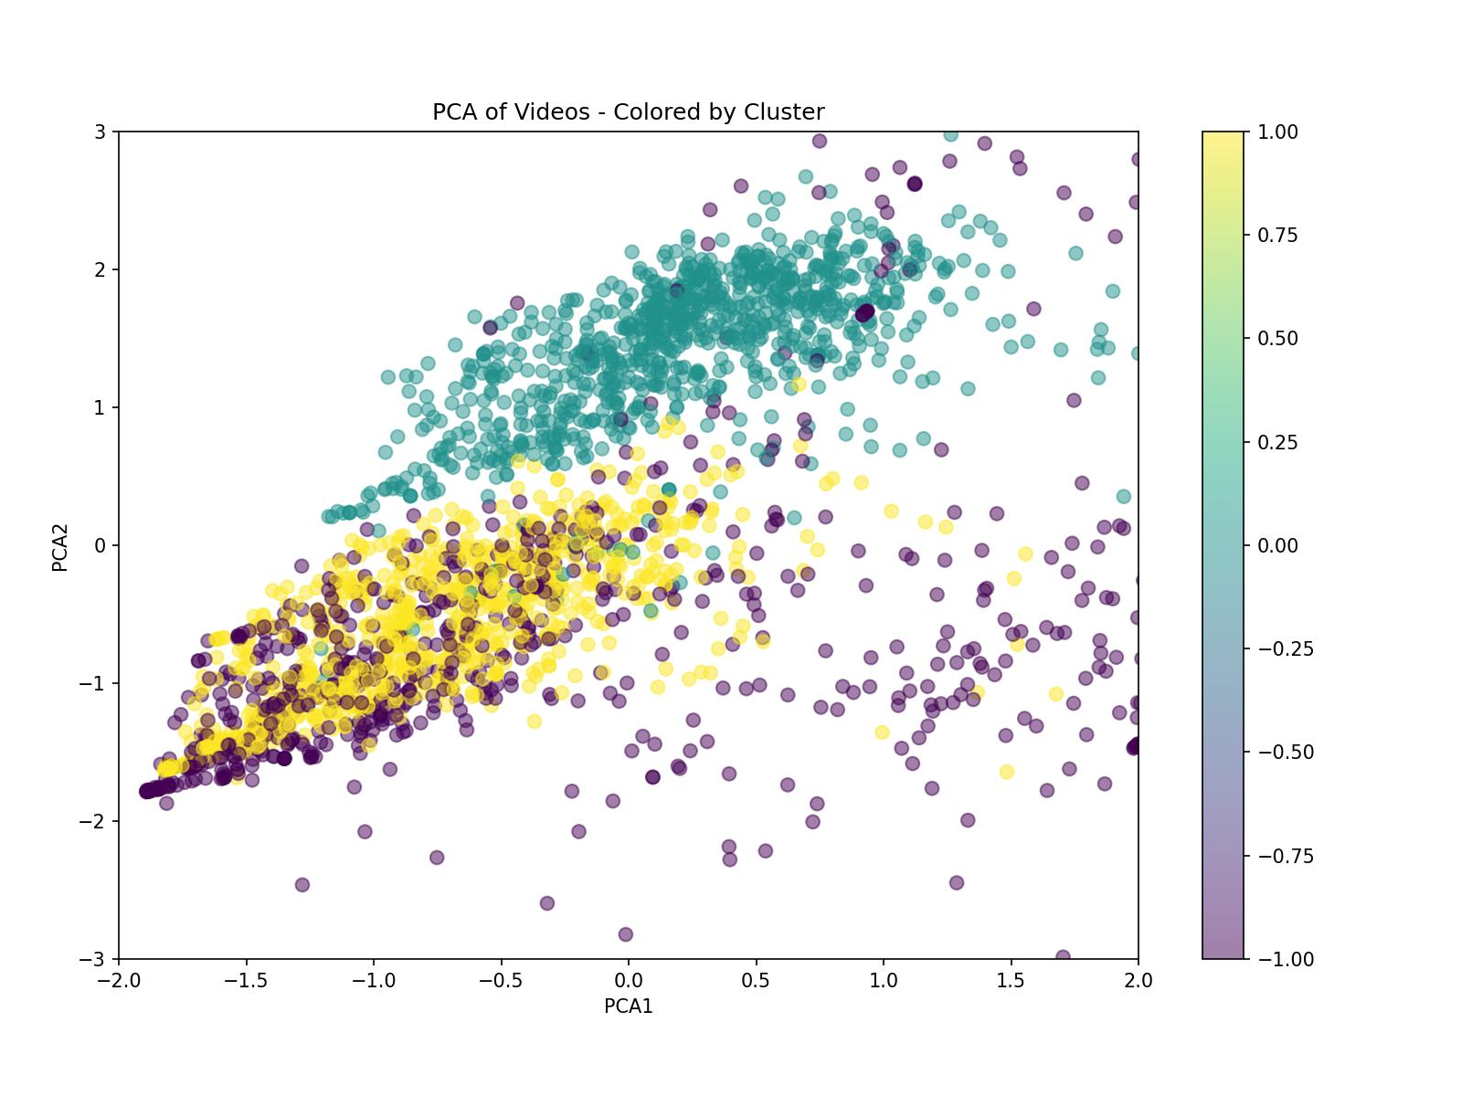
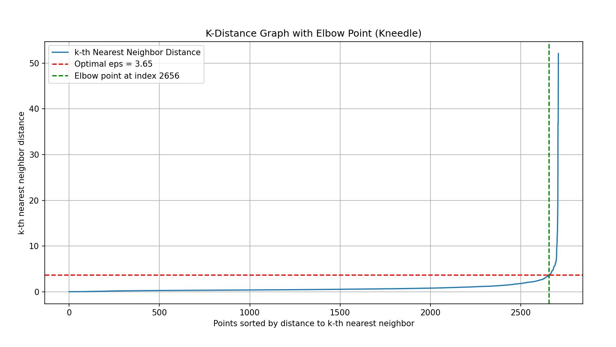
DBSCAN
dbscan_model = DBSCAN(eps=2.65, min_samples=450)
Number of clusters: 2
Number of noise points (-1): 762
silhouette_avg_score = 0.3891
DATOS
MATRIZ SIMILITUD
ANÁLISIS DE SENTIMIENTOS
CLUSTERING
RESULTADOS

Slide 21
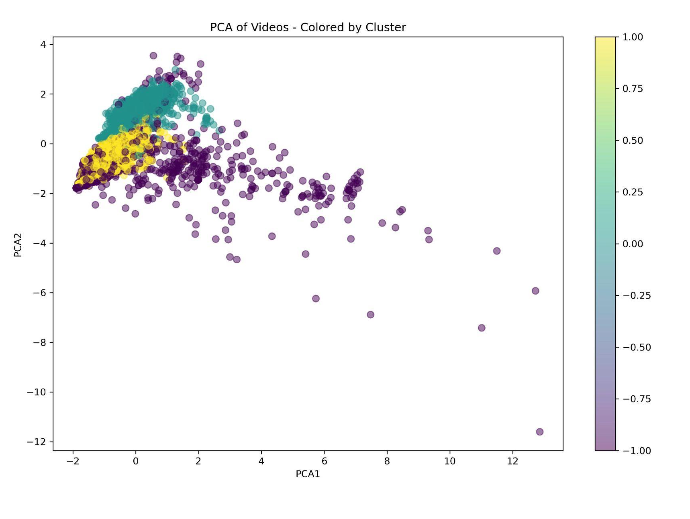
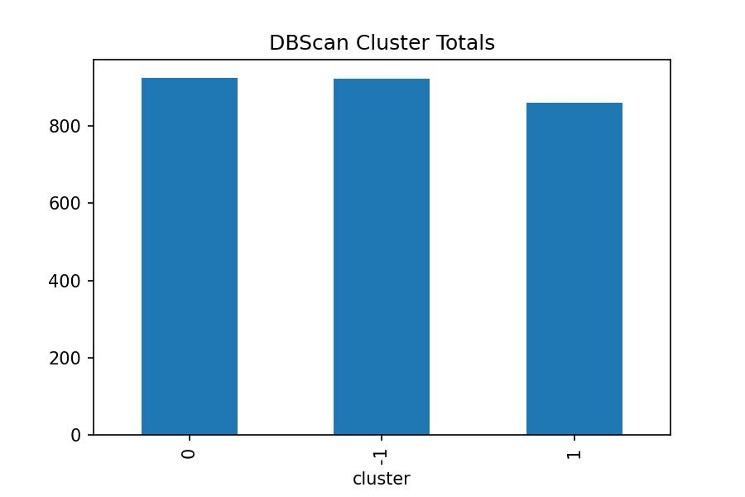
CLUSTERIZACIÓN ELEGIDA: DBSCAN
DATOS
MATRIZ SIMILITUD
ANÁLISIS DE SENTIMIENTOS
CLUSTERING
RESULTADOS

Slide 22
APLICACIÓN FINAL

Slide 23
CÁLCULO DEL FINAL_SCORE
Final Score = Matriz Similitud Score x Sentiment Score × Clusters Boost
Sentiment Score = (1 + Weighted Sentiment)
Cluster Boost = 1.2
DATOS
MATRIZ SIMILITUD
ANÁLISIS DE SENTIMIENTOS
CLUSTERING
RESULTADOS

Slide 24
RESULTADOS
PRUEBA 1
| video_id | title |
|:------------|:--------------------------------------------------------------|
| I-aLMhRwfL0 | How Warren Buffett INVESTS In Artificial Intelligence #shorts |
| video_id | title | final_score |
|:------------|:--------------------------------------------------------------------------------------------------|--------------:|
| -EpRqaPAOz4 | Applications of Artificial Intelligence in Business. – [Hindi]- Quick Support | 0.440083 |
| wlNJiBWklzg | 2021 Artificial intelligence outlook: Language, automation and trust are key to AI: IBM SVP | 0.424335 |
| ja06VL8vYmk | #ONPASSIVE - The Future is Now, August 2024 #ai #AI #onpassiveai #aitools #artificialintelligence | 0.422861 |
| Pjg3p6DFmlc | Senate hearing on Oversight of A.I.: Rules for Artificial Intelligence | 0.380852 |
| NdoydRqVOV4 | The Imaging Wire Show - Change Healthcare’s AI Adoption Roadmap | 0.357064 |
PRUEBA 2
| video_id | title |
|:------------|:----------------------------------------------------------------------------------------------------|
| BlYFE3jXlKE | 😍Top 6 Artificial Intelligence Stocks for Investments#shorts#ytshorts #investing#ai#viral#trending |
| video_id | title | final_score |
|:------------|:------------------------------------------------------------------------|--------------:|
| NoMpupqag2Y | Is Artificial Intelligence Taking Over Finance | 0.402001 |
| LCOK9nO_Dys | Artificial intelligence: Experts warn of AI extinction threat to humans | 0.19056 |
| qB4HGMvrhwE | 2024 Twelve Best FREE AI tools for Academic Research and Researchers | 0.147023 |
| do5wrddhyPU | What is India's role in Artificial Intelligence technology? | 0.14112 |
| zKaxW8HduNU | 9 Step Guide for a proper Machine Learning model!!! | 0.132497 |

Slide 25
RESULTADOS
PRUEBA 3
| video_id | title |
|:------------|:-------------------------------|
| QVg37-m4Ia4 | The Future of AI in Healthcare |
| video_id | title | final_score |
|:------------|:---------------------------------------------------------------------------------------------------|--------------:|
| fFtwJLUVyg8 | Applications of AI for Healthcare and Medicine (Muhammad Mamdani, PharmD) | 0.916202 |
| u0oTLNmXINE | Revolutionizing Healthcare - AI and machine learning for early detection and diagnosis (1/2) | 0.890791 |
| AuvVHAPX2R8 | #80 AI - Artificial Intelligence in Healthcare discussion with Dr. Janak Gunatilleke | João Bocas | 0.788551 |
| AONZoaWC9v4 | AI & Machine Learning in Finance: AI Applications in the Financial Industry - Panel Discussion | 0.687893 |
| 4gcDNtvXHPM | A.I. Enabled Healthcare: Potential & Challenges. DeepMind's Dr. Alan Karthikesalingam | 0.677443 |
PRUEBA 4
| video_id | title |
|:------------|:----------------------------------------------------------------------------------------------|
| X5ib9dnGERo | Will AI robots rule the world? #ai #robot #airobotics #robotics #uts #technology #innovation |
| video_id | title | final_score |
|:------------|:----------------------------------------------------------------------------------------------|--------------:|
| qIvkEEIA7dA | Myth or Fact? AI will replace all jobs #futureofwork #ai #robotics #robots #technology #uts | 0.739898 |
| 53K1dMyslJg | The Rise of Artificial Intelligence | Off Book | PBS Digital Studios | 0.542543 |
| Z5s4cWbZX6E | The Ethics of Artificial Intelligence | 0.427623 |
| S9D7qgcoiYc | Artificial Intelligence, Ethics, and Society | Institute for Advanced Study | 0.411608 |
| AT8JCkJH9pY | The Future of Artificial Intelligence - Shaping our AI Futures | 0.403217 |

Slide 26
RESULTADOS
PRUEBA 5
| video_id | title |
|:------------|:--------------------------------------------|
| 7gEzEAIELgQ | Machine Learning Explained 🔥in 30 Seconds. |
| video_id | title | final_score |
|:------------|:----------------------------------------------------------------------------------------------------|--------------:|
| snYHLqEtheI | How to be a Software Engineer , Ethical Hacker , Data Scientist , Artificial Intelligence | Eduport | 1.0311 |
| PfY187sxquI | Artificial Intelligence | Explained in Malayalam | 0.969247 |
| Al4bwR--BgY | 5 free resources to help you get a machine learning job | 0.958583 |
| HgBpFaATdoA | What Is Machine Learning? | What Is Machine Learning And How Does It Work? | Simplilearn | 0.903009 |
| b4aE9gWpr0A | Artificial Intelligence in HealthCare | Can AI replace Doctors? | Tamil | Rams Universe | 0.777466 |
PRUEBA 6
| video_id | title |
|:------------|:-------------------------------------------------------|
| IikHET7tR8Y | The future of autonomous vehicles. #autonomousvehicles |
| video_id | title | final_score |
|:------------|:---------------------------------------------------------------------------------|--------------:|
| 4GPmdmn9_ZE | AI in Transportation Shaping the Future of Autonomous Vehicles and Smart Cities | 1.28337 |
| 0Z1tVL3Wh8I | AI in Autonomous Vehicles! | 0.740036 |
| 0CqyPmLw8X4 | AI in Transportation From Autonomous Vehicles to Traffic Management #shorts #ai | 0.728683 |
| qpoGoI742gA | How AI is Driving the Future: The Rise of Autonomous Vehicles | 0.723037 |
| 2CLKChuKbcE | How AI is Transforming Transportation: An Inside Look at Autonomous Vehicles! | 0.692267 |

Slide 27
PRÓXIMOS PASOS
Implementar métricas de evaluación como Precisión@K o Recall@K tras analizar el desempeño de las recomendaciones actuales
Refinar la agrupación de videos con DBSCAN para mayor diversidad
Realizar pruebas A/B para valorar las mejoras
Optimizar el sistema para escalabilidad y recomendaciones en tiempo real

Slide 28
MUCHAS GRACIAS!

